Slide 1
Montana Climbing Holds
Akash Kum
Elena Kargopoltsev
Julie Kangl
Kyle Has

Slide 2
Agenda
Introduction
DFD Diagrams
Data Specification
E-Commerce Assessment
Conclusion

Slide 3
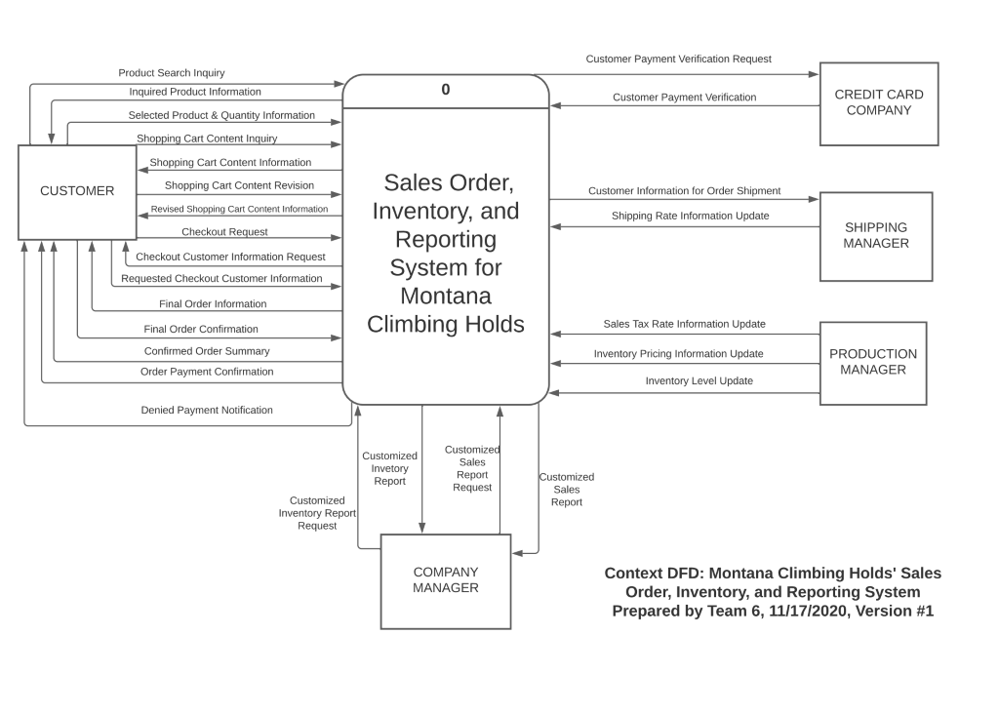
Context DFD

Slide 4
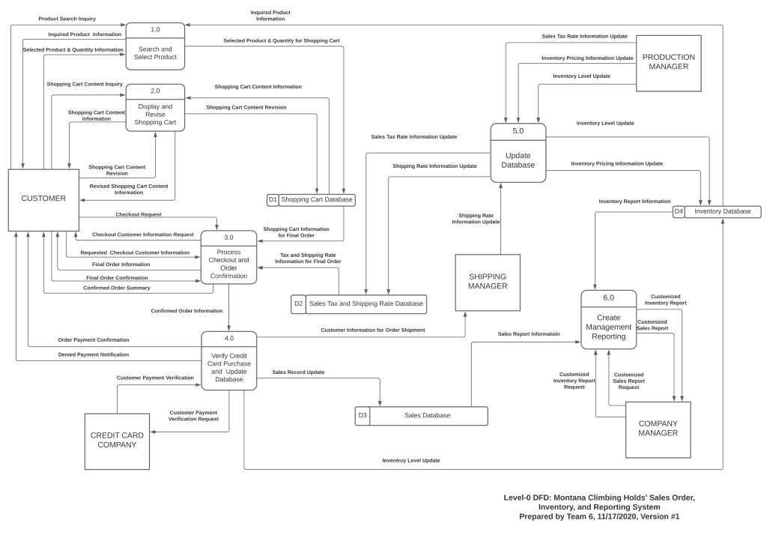
Level-0 DFD

Slide 5
Level-0 DFD
Order and Payment Processing
Customer Selection
Payment Processing
Verification of Payment Method

Slide 6
Level-0 DFD
Updating Databases
Sales Tax and Shipping Rate Database
Inventory Database

Slide 7
Level-0 DFD
Creating Management Reporting
Customized Inventory Report
Customized Sales Report

Slide 8
E-Commerce Assessment
Weebly, Shopify, Squarespace
3 E-commerce Services where you design your own website from templates or from scratch.
Our Recommendation:
Weebly.com
Meets all of the requested software requirements
Low cost per month at only $26/month
Lots of support from Weebly staff or from community forums
Integrated inventory management, marketing, and online order management

Slide 9
Conclusion
Montana Climbing Holds is an innovative business idea
Working asynchronously proved to be difficult at times
Time management and scheduling allowed us to complete the project

